Slide 1









QUALITY AND CONSISTENCY
04/06/2019
CERVEZA TYRIS VALENCIA

Slide 2





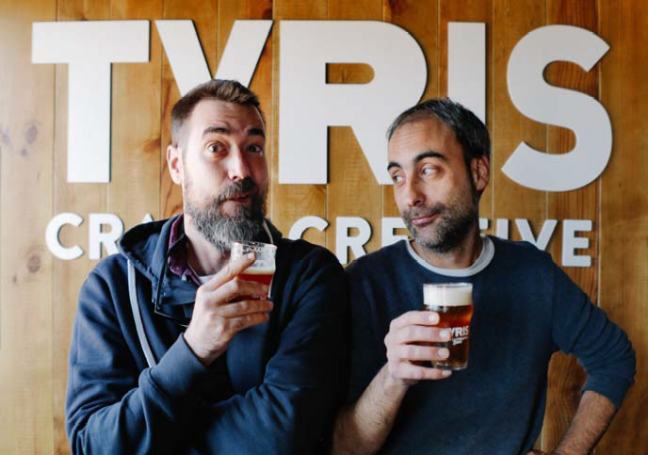



CERVEZA TYRIS
 GONZALO ABIA 07/06/78
 CO-FOUNDER AND CEO TYRIS BREWERY (2009)
 TYRIS MARKETING AND SALES MANAGER
 GEOGRAPHER, MBA
 MAD ABOUT BEER
 PASSIONATE TRAVELLER

Slide 3





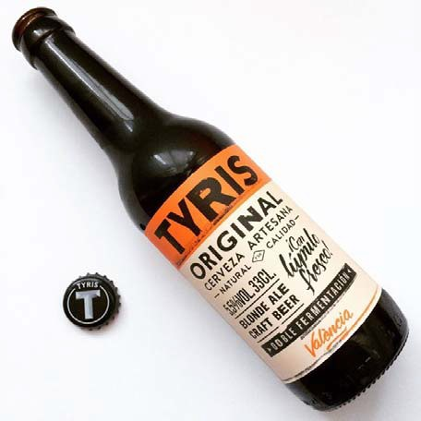



TYRIS HISTORY
 2009 BRAUMEISTER 50 LITRES
 ONLY 8 CRAFT BREWERIES IN SPAIN AT THAT POINT AND 6 BIG GROUPS CONTROLLING THE MARKET
 FINANCIAL CRISIS, SPAIN AS WINE COUNTRY AND CULTURE
 NO BEER EXPERIENCE NO MARKET NO COMPETITORS
 2009-2014 CONTINUOUS GROWTH (SLOWL BUT STEADY)
From 200-400-10HL NO MORE ROOM AND THE AMBITION OF HAVING OUR OWN TAP ROOM
 2018 NEW BREWERY 40 HL 10000HL/YEAR

Slide 4





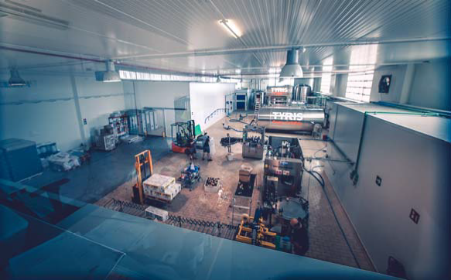



WHAT DID WE CHANGE
 AT THE BEGINNING THE FOCUS WAS ON :
 SMALL SHOPS AND RESTAURANTS
 FROM EARLY ADOPTERS TO MASS CONSUMERISM
 BREWING DEMOCRATIC BEERS (TO PAY THE BILLS)
 AND SOME CRAZY STUFF (90% / 10%) WITH FRIENDS
 MARKET DEVELOPMENT CONSUMER HABITS
 NEW CUSTOMER DEMAND GUARANTEE OF QUALITY AND CONSISTENCY
 NEW CUSTOMERS
 ON TRADE, TO SATISFY BIG VOLUME IN ORDER TO ENSURE SERVICE AND KEEP THE WOW FACTOR.

Slide 5





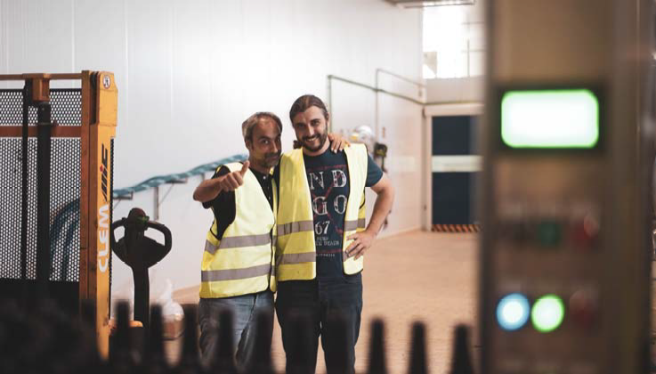



EXTERNAL REQUIREMENT / INTERNAL DUTY : QUALITY, BASICS FOR MICROBREWERY
 FOOD SAFETY GUARANTEE
 PLANNING MEDIUM LONG-TERM
 WEEKLY PROGRAM
 CONSISTENCY

Slide 6





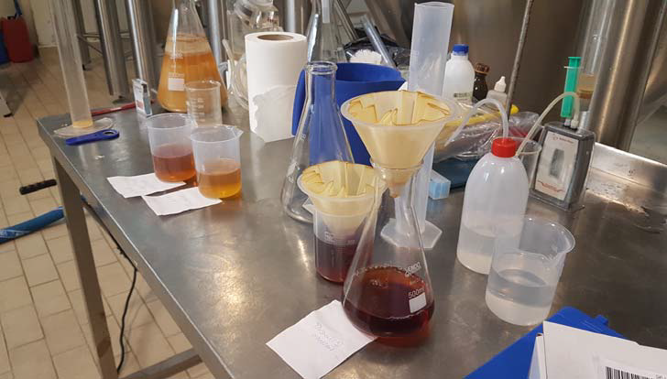



IN HOUSE QUALITY, LANDING AT THE BREWERY
 BRAND NEW AND SELF DEVELOPED ERP:
 PRODUCTION, LOGISTICS, HUMAN RESOURCES AND MARKETING, INVENTORY, STATISTICS, CRM…
 CONTINUOUS IMPROVEMENT:
 SUPPLIER CONTROL AND APROVAL
 MANAGEMENT OF INCIDENTS AND CLAIMS
 STANDARIZE PROCESS, LIKE CLEANING, BREWING, LOGISTICS ETC....
 Size everything possible

Slide 7





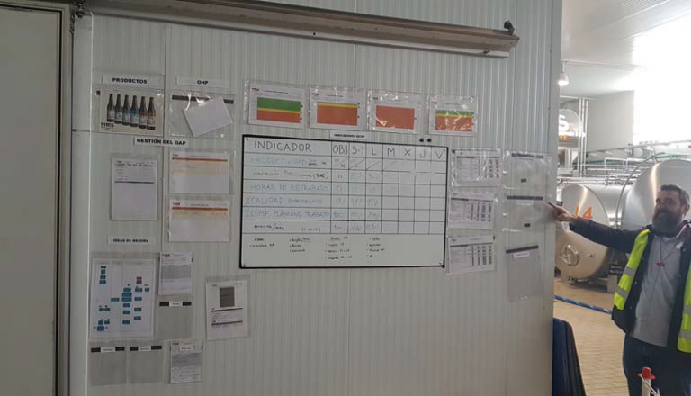



KEY PERFORMANCE INDICATORS
◆ QUALITY PARAMETERS: EXTERNAL LABORATORY IN CERVECEROS DE ESPAÑA:
 RAW MATERIALS: HUMIDITY HEAVY METALS, IMPURITIES …
 PRODUCT IN PROCESS: DENSITY, PH, ALCOHOL, BEER SPOILERS, TEMPERATURES, CO2 ETC…
 FINISHED PRODUCT: COLOR, CO2, BITTERNESS, DRY EXTRACT, %ABV, ORGANOLEPTIC

Slide 8





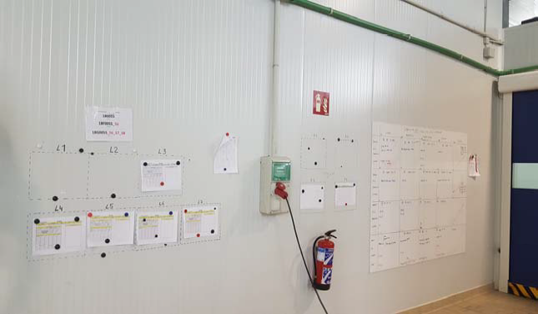



KEY PERFOMANCE INDICATORS
 BREW HOUSE PERFORMANCE (KG/MALT WORT)
 % ATTENUATION
 BOTTLING PRODUCTIVITY (BOT/WORKER/HOUR)
 QUALITY IN PROCESS (SUCCESS)
 WORKING PLAN ACCOMPLISHMENT
 SERVICE RATE
 MONETISED LITRES VS BOTTLED (RATE OF LOSSES)

Slide 9





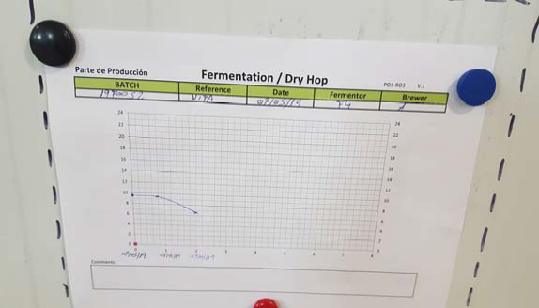


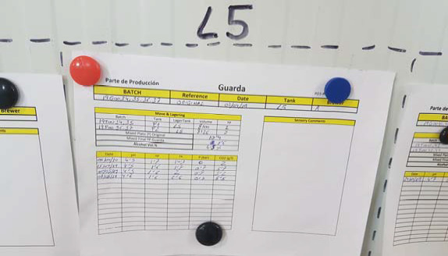

NON VISUAL FEEDBACK ( NOT ONLY SECURITY)
 QUALITY GIVE US A COMPETITIVE ADVANTAGE
 REDUCE COMPETITION (NO WAY TO COMPARE)
 THE CUSTOMER TRUSTS US, RELAY ON THE BRAND
 SELLERS TRUST OUR PRODUCT, FINAL CUSTOMER AND IN MIDDLE CLIENT
 BRAND IS RELATED WITH QUALITY
 WORKING ON THE MOST EXIGENT MARKET ALLOWS US TO WORK IN OTHER CUSTOMER FIELDS, WHICH GIVES US THE OPPORTUNITY TO KEEP GROWING AND DIVERSIFY OUR MARKET, LESS RISIKO.
 WE CAN FEEL SURE ABOUT OUR FUTURE ON DIFFERENT MARKET STAGES
 ALLOWS WORK IN OTHER INTERNATIONAL MARKETS

Slide 10









NEXT AIM: CERTIFICATION
 NEXT CHALLENGE IS TO BE THE FIRST ISO AND IFS SMALL BREWERY IN SPAIN
 THAT SHOULD GIVE US BACK GROW, BRAND VALUE AND REAL QUALITY OF OUR BEER OBJECTIVE AND SUBJECTIVE
 BETTER COMPANY VALUE
 2019-2021 AIMS 30% YEARLY GROW

